Slide 1
HIRING PROCESS ANALYSIS
BY Sathish
Data Analyst
08 Feb 2024

Slide 2




Project Description :
The hiring process is a crucial function of any company, and understanding trends such as the number of rejections, interviews, job types, and vacancies can provide valuable insights for the hiring department.
My task here was to provide the management team with the data driven solutions for the questions posed.

Slide 3
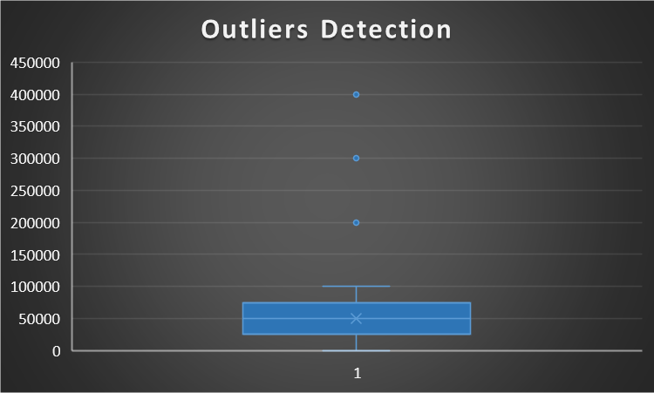
Approach :
Handling Duplicates:
Dataset was thoroughly checked for duplicates and there were no duplicates found.
Outliers Detection and Treatment:
Box plot identified the salaries above Rs. 1,00,000 as Outliers (marked as "Dots" in the above chart).
I considered trimming as the best suited method for treating outliers in this case. Hence, the affected data has been excluded from the scope of the analysis.

Slide 4
Approach :
Handling Missing Data
There was one null value in the 'Salary Offered' column which has been imputed using Mean Imputation Technique.
Analysis
Utilized Microsoft Excel skills to analyze the data and extract valuable, data-driven insights.
Communicating Insights
Utilized Excel charts to visually represent the insights and findings to make it more understandable.
Tech Stack Used
All the insights, including the visualization were derived using Microsoft Excel 365.
I consider Microsoft Excel as the best suited tool for this analysis as the dataset was small in size and the analysis demands the use of Statistics.

Slide 5

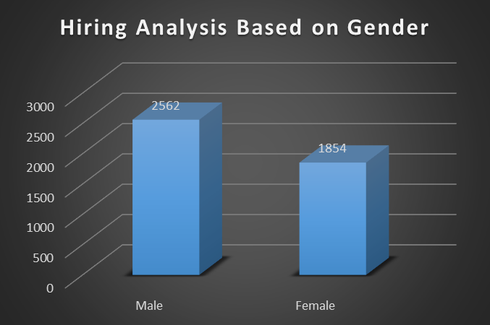
Insights :
A. Hiring Analysis:
Task: To determine the gender distribution of the Hired applicants.
Out of the total of 7165 applicants, 4416 applicants are hired by the company which consists 2562 Males and 1854 Females.

Slide 6
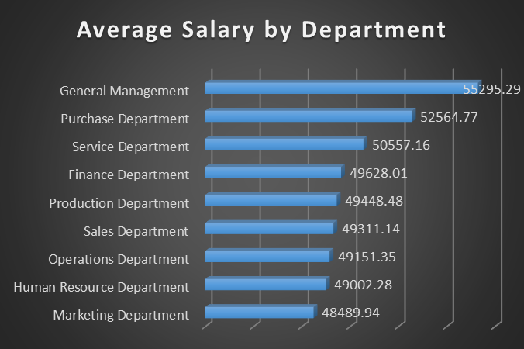
Insights :
B. Salary Analysis:
Task: To calculate the average salary offered by the Company.
The average salary offered by the Company is Rs. 49878. 'General Department' has the highest average salary and the 'Marketing Department' with the lowest.

Slide 7
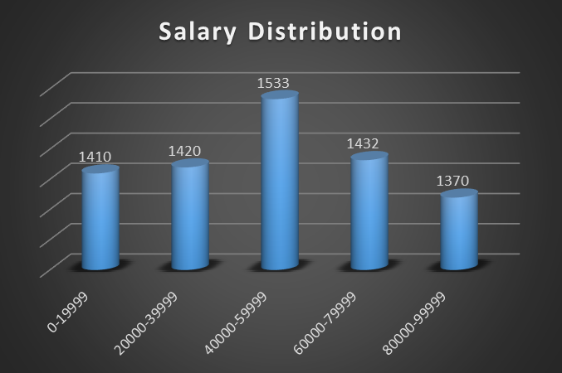
Insights:
C. Salary Distribution:
Task: To create class intervals for the salaries in the company to understand the salary distribution.
Observation on the Salary Distribution reveals that majority of the employees are offered with the salary range of Rs.40000 to Rs.59999.

Slide 8
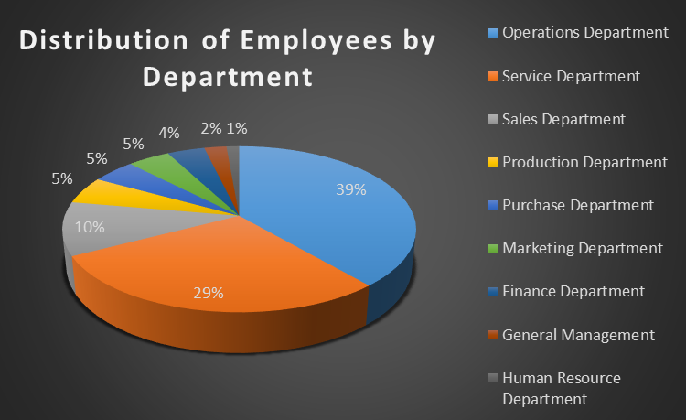
Insights:
D. Departmental Analysis:
Task: To visually represent the proportion of employees working in different departments.
'Operation Department' has the highest count of employees consisting of 39% of the Company's total workforce and lowest being the 'Human Resource Department' with only 1.45%.

Slide 9
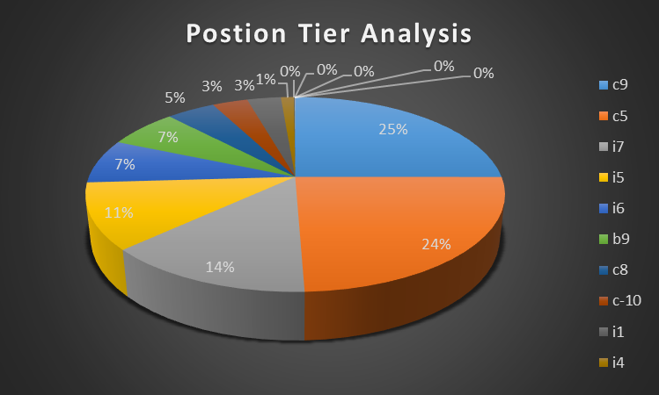
Insights:
E. Position Tier Analysis:
Task: To graphically represent the different positions within the company.
Position 'c9' and 'c5' are among the positions consisting around 25% each of total workforce. 'm6', 'n9', 'n6', 'm7', 'n10' holds one employees each.

Slide 10
THANK YOU
Feel free to access the excel file that I worked : Link
sathishgudri@gmail.com

